Slide 1

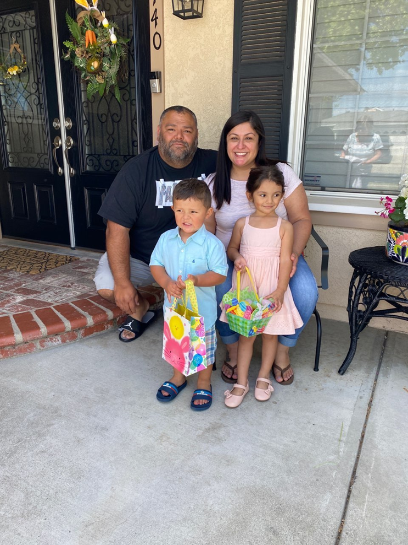
Welcome to Back to School Night!
2023-2024
Mrs. Franco
^{6th Grade}
This Photo by Unknown Author is licensed under CC BY-SA

Slide 2

Student Expectations
Students are expected to follow PAWS
Rewards:
Class Marble Jar
Class tickets
  Students earn 1 ticket each day that they don’t earn a consequence
Reward Store (bi-weekly)
Trimester Auction
Consequences:
1st Offense: Redirect
2nd Offense: Sideline
3rd Offense: Reflect
4th Offense: Letter Home
All major offenses will result in an office referral.
A copy of the letter with our classroom management program has been provided.

Slide 3

Projects
Homework
Students are expected to write HW in their agendas daily.
Nightly HW:
  30 minutes of reading
  5 to 10 Math problems to help reinforce concepts taught. Math Notes should be going home nightly.
  No HW given on Fridays
Homework is due at the start of class
  Missing/late HW and Classwork affects your child’s Homework grade on the report card.
There will be projects due throughout the year.
Students and parents will be notified in advance of due dates
All necessary requirements will be given

Slide 4

Grading Policy
Test/Assignments
Performance Levels based on a 1-4 rubric
Level 1: 49% or below (Beginning)
  Not meeting grade level standards
Level 2 : 50% - 69% (Progressing)
  Partially meeting grade level standards
Level 3: 70% - 89% (Achieving)
  Consistently meeting grade level standards
Level 4: 90% - 100% (Extending)
  In-depth understanding
Homework and Classwork Grading Policy​
4 = 0-2 missing assignments​
3 = 3-5 missing assignments​
2 = 6-8 missing assignments​
1 = 9 or more missing assignments​

Slide 5


IF YOUR CHILD IS ABSENT…
While You Were Out…
When your child returns to class, they will have a folder on their desk with their absent work (They will have as many days as they were absent to complete the work).
Requesting Work
Contact the office to request your child’s materials and any absent work
  Textbooks, notebooks, *Chromebooks
  Absent work will be brought to the office by 3:00pm and must be picked up by 4:00pm.
Extracurricular Activities:​
Students who miss class due to participation in extracurricular activities (band, Christian Release, Student Council, etc.) are accountable for all missed work. ​
​

Slide 6
How will I communicate with you?
Weekly Folders
*Graded work
Email
*Specific behavior/academic concerns
Phone Call Home
*Specific behavior/academic concerns
Letter Home (per our management program)
*Fourth offense
ClassDojo
*Class Announcements

Slide 7
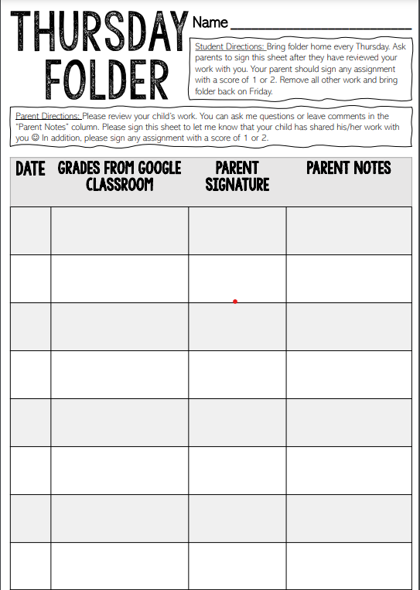
Weekly Folders
Blue Folders:
  Will go home every THURSDAY
  Please review graded work and sign any test/quiz with a 2 or below and return it in folder.
  Your child will hand-write any “digital” grades from Google Classroom, Big Ideas Math, or McGraw Hill ConnectEd.
  Please sign the Thursday sheet to indicate you have reviewed their graded work.
  Send folder back to school with your child on Friday.

Slide 8


Communication
Make sure you are signed up on Aeries and check the PawPrint and website weekly for school announcements
ClassDojo
  Class Announcements are posted in “Class Story”
    Comments left on “Story” are public
  Private messaging: General Questions Only
Email
  Specific questions, concerns, and comments
Melissa_Franco@chino.k12.ca.us

Slide 9

Technology
One – One devices in the classroom
Chromebooks are checked out to students will go home as needed.
Some assignments will be completed in Google Classroom Big Ideas, or McGraw Hill ConnectEd​
Students access apps through ClassLink (on Oak Ridge Homepage)

Slide 10

Math
The Number System
Expressions and Equations
Ratios and Proportional Relationships
Statistics
And
Probability
Geometry
*Must Know Multiplication Facts
Materials
  Textbook
  Record and Practice Journal
  Notebooks (2)
  Whiteboard and marker
  Some assignments to be completed in Big Ideas Math Online
  Students can access textbook online

Slide 11

English
Language
Arts (ELA)
Reading: Literature
Reading: Informational Text
Speaking and Listening
Language
Conventions
(Grammar)
Wonders
Novel Studies
Integration of text
(compare/contrast)
Key Ideas and Details
Craft and Structure
(meaning of text)
Vocabulary Acquisition and Use

Slide 12

Writing
Informative/Explanatory
  Write texts to examine a topic and convey ideas and information
Argumentative
  Write arguments to support claims with evidence to support
Narrative
  Write real or imagined experiences

Slide 13

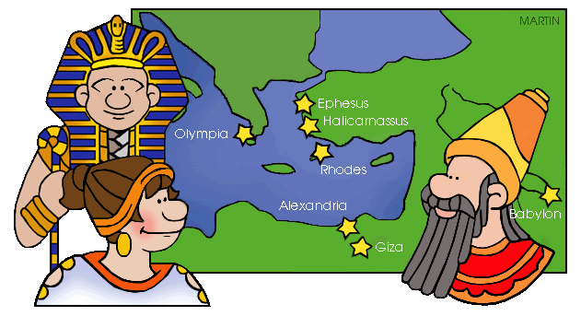
Social Studies
Science
Ancient Civilizations
Mesopotamia
Egypt
Greece
Rome
India
China
NGSS (Next Generation Science Standards)
  Discovery Education
Systems on Earth
Causes of Weather
Causes and Effects of Regional Climate

Slide 14
Parent – Teacher Conferences
Parent Conferences can be held in person or virtually through ZOOM
  Held the week of September 25th
  Each conference will be about 15 minutes
  Information with a Sign-Up Genius will be sent through ClassDojo the week of September 11th

Slide 15

Volunteers:
4 Class Parties: Harvest, Winter, Valentine’s, End of the Year
Art Prep
6th Knott’s Berry Farm
Field Day
Sign-ups are on the counter near the
sink for both Classroom Volunteers and
Art Prep

Slide 16

Teacher Wish List:
Tissue boxes
Disinfectant Wipes
Sticky notes
Expo markers
Glue sticks
Markers
Colored pencils
Graph paper
College ruled paper/college ruled notebooks
This Photo by Unknown Author is licensed under CC BY-NC

